Slide 1
RAND WATER SUPPLY SYSTEM
11 November 2023

Slide 2
Rand Water Systems
(DISCHARGE THE MANDATE)

Slide 3
Supply system
Customers (Municipalities)
Booster Systems
Eikenhof Supply System
1200 MI/d
Zwartkopjes Supply System
600 MI/d
Palmiet Supply System
1850 MI/d
Mapleton Supply System
800 MI/d
Primary
Systems
Vereeniging Purification System
1 200 Ml/d
Zuikerbosch Purification System
3 800 Ml/d
Raw Water Supply System
5202 MI/d(including 202 MI/d for Authorised users)

Slide 4
Supply system (2)
Zuikerbosch
3 800 Ml/d
Eskom
Eikenhof system 600 Ml/d
City Power
Zwartkopjes system 400 Ml/d
Eskom
Palmiet system 1 800 Ml/d
Eskom
Mapleton system 800 Ml/d
Ekurhuleni
Meredale, Weltevreden,
Waterval, Krugersdorp Reservoirs
Benoni,
Yeoville, Ennerdale, Meredale and Foresthill Reservoirs
Klipriviersberg, Germiston, Meyershill, Airfield, Klipfontein, Brakfontein, Haartebeeshoek Reservoirs
Brakpan, Vlakfontein, Bronberg, Selcourt, Wildebeesfontein, Stopmpies Reservoirs
Joburg
Rand West
Mogale City
Rustenburg
Merafong
Mines
Joburg
Ekurhuleni
Industries
City of Joburg
City of Tshwane
City of Ekurhuleni
Madibeng
City of Tshwane
City of Ekurhuleni
Thembisile Hani
Lesedi
Govan Mbeki
Victor Khanye

Slide 5
Supply system (3)
Vereeniging
1 200 Ml/d
Emfuleni
Eikenhof system 600 Ml/d
City Power
Zwartkopjes system
300 Ml/d
Eskom
VVS system
300 Ml/d
Emfuleni
Meredale, Weltevreden,
Waterval, Krugersdorp Reservoirs
Benoni,
Yeoville, Ennerdale, Meredale and Foresthill Reservoirs
Sasolburg &
Langerand
Reservoirs
Joburg
Rand West
Mogale City
Rustenburg
Merafong
Mines
Emfuleni
Metsimaholo
Ngwathe
Joburg
Ekurhuleni
Industries

Slide 6
Rand Water Systems
(DISCHARGE THE MANDATE)

Slide 7
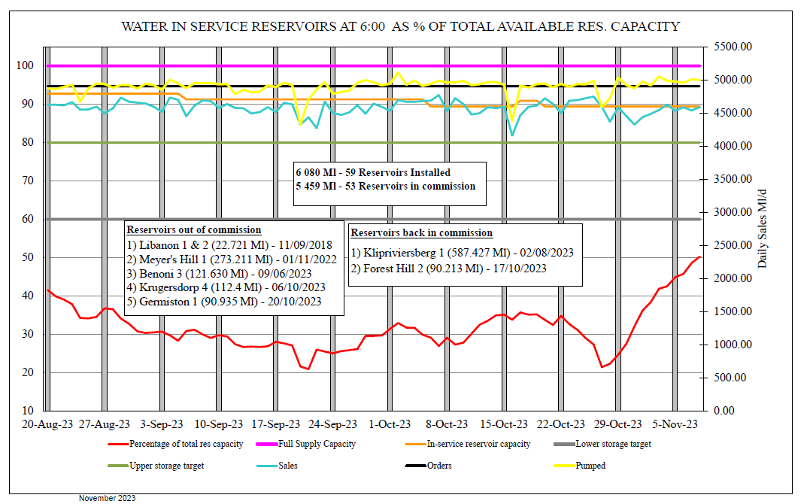
Pumping, Sales & Storage

Slide 8
Critical reservoirs
 | 07 NOVEMBER 2023 | 08 NOVEMBER 2023 | 09 NOVEMBER 2023
MAPLETON SYSTEM
Vlakfontein No. 1 | 51 | 70 | 72
Vlakfontein No. 2 | 54 | 73 | 75
Brakpan No. 1 | 80 | 61 | 66
Brakpan No. 2 | 82 | 64 | 67
Brakpan No. 3 | 77 | 58 | 61
Bronberge | 54 | 81 | 70
PALMIET SYSTEM
Klipriviersberg No.1 | 29 | 35 | 41
Klipriviersberg No.2 | 28 | 33 | 40
Germiston | O/C | O/C | O/C
North Ridge | 72 | 77 | 86
Klipfontein No.1 | 59 | 60 | 59
Klipfontein No.2 | 60 | 61 | 60
Brakfontein | 54 | 54 | 51
Hartebeesthoek | 61 | 60 | 61
EIKENHOF SYSTEM
Meredale No.1 | 45 | 48 | 58
Meredale No.2 | 44 | 57 | 60
Waterval No.1 | 52 | 61 | 78
Waterval No. 2 | 31 | 54 | 63
ZWARTKOPJES SYSTEM
Benoni | 87 | 89 | 66
Forest Hill No. 1 | 65 | 73 | 86
Forest Hill No. 2 | 65 | 71 | 84
Forest Hill No. 3 | 60 | 61 | 64

Slide 9
CONSUMPTION
(FOCUS ON METROS)

Slide 10
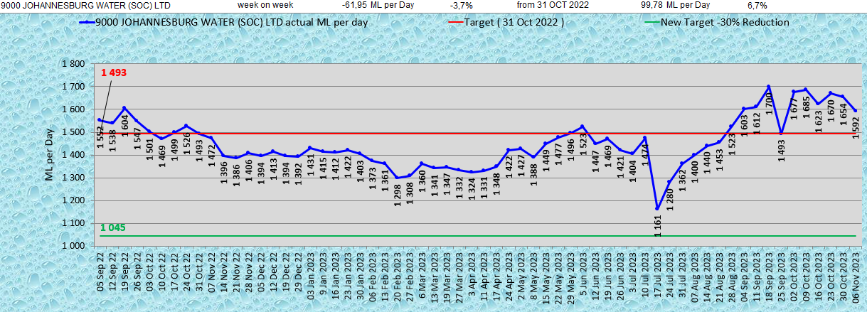
City of Joburg weekly consumptions
Johannesburg Water
Consumption slightly decreased, but still above target; 99,8 Mℓ/d or 6,7% above target
Decrease by 62 Mℓ/d or 3,7% from last week.

Slide 11
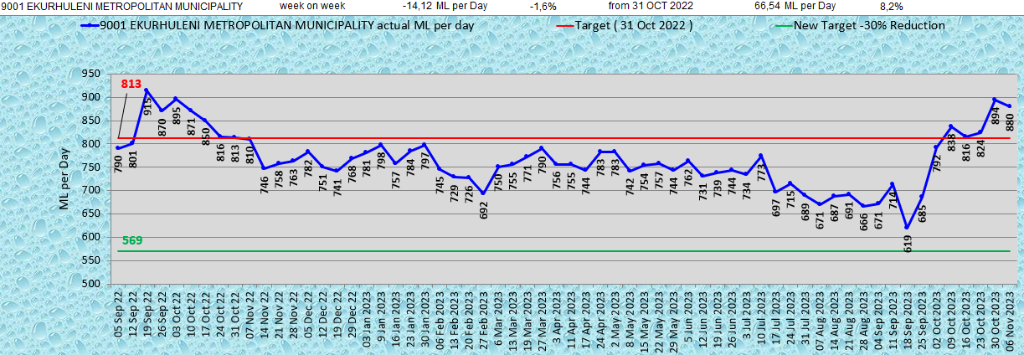
City of Ekurhuleni weekly consumptions
City of Ekurhuleni
Consumption slightly decreased, but still above target; 66,5 Mℓ/d or 8,2% above target .
Decreased by 14,1 Mℓ/d or 1,6% from last week.

Slide 12
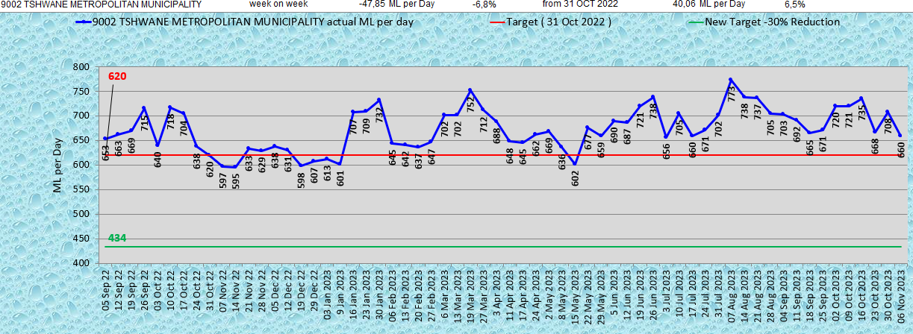
City of Tshwane weekly consumptions
City of Tshwane
Consumption decreased, but still above target; 40 Mℓ/d or 6,5% above target
Decreased by 47,9 Mℓ/d or 6,8% from last week.

Slide 13
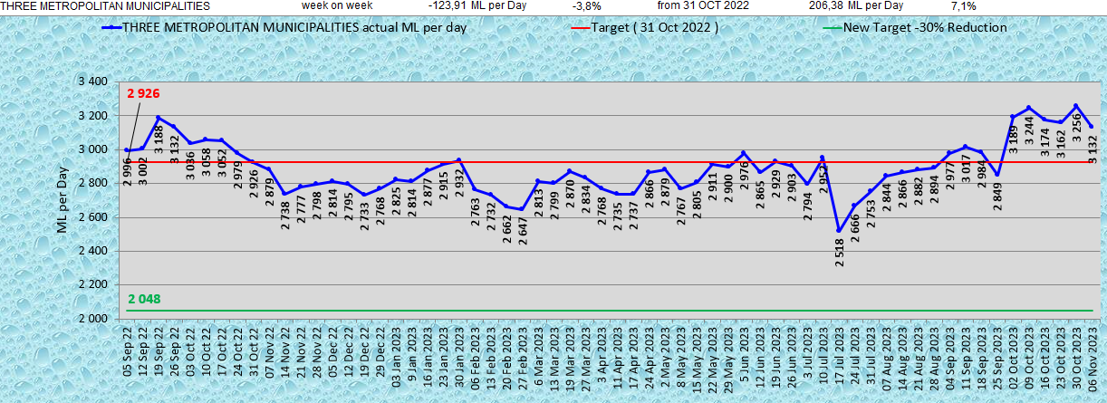
Three Metros weekly consumptions

Slide 14
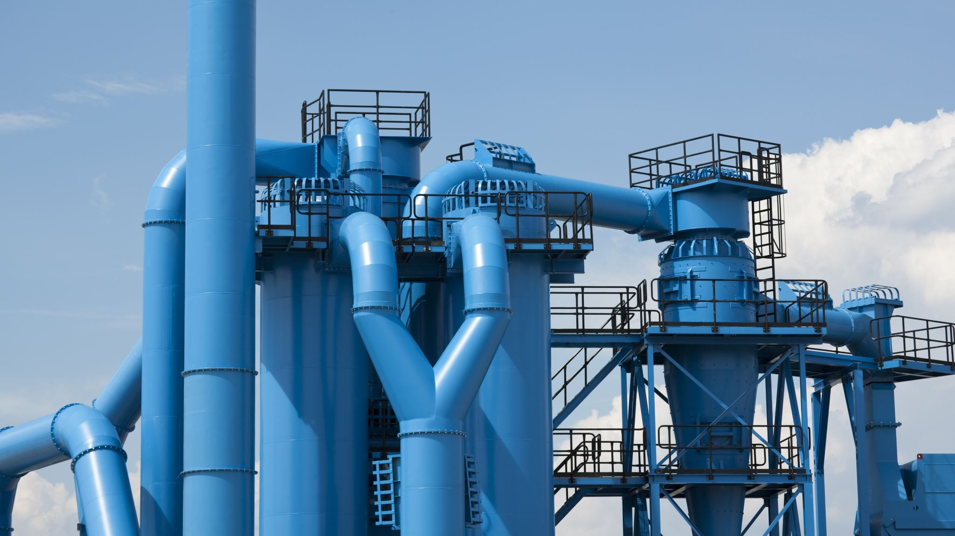

Slide 15
