Slide 1
WATER SUPPLY IN JOHANNESBURG
11 November 2023

Slide 2
DWS raw water supply to the Integrated Vaal River System
DWS sells raw (untreated) water to Rand Water
RW abstracts raw water from the Integrated Vaal River System (IVRS) and treats it
Municipalities in Gauteng buy treated water from Rand Water (RW)
Rand Water stores the treated water in bulk storage reservoirs and pumps it into municipalities’ reservoirs. From there the water is mostly gravity-fed to households
To ensure a continuous supply of water to users even in times of drought, the Department of Water and Sanitation (DWS) sets a limit on the amount of raw water that Rand Water can abstract from the IVRS
The abstraction limit is set by DWS by applying well developed hydrological models
Dam storage levels can fall rapidly when there is a drought, and it would be irresponsible to raise the abstraction limit when the dams are full
Gauteng is a water-scarce area within a water-scarce country
There is not enough naturally occurring water in the IVRS to supply the demand for water in Gauteng
Demand for water in Gauteng has grown rapidly, largely due to population growth
DWS planners anticipated growth in demand – put in place Lesotho Highlands Water Project (LHWP), to transfer water from mountains in Lesotho into the IVRS
Phase 1 (Katse Dam and Mohale Dam) was completed in 2003. R40 billion Phase 2 of the LHWP (Polihali Dam) was due to come online in 2019. Has been delayed by nine years. Now under construction, due to be completed by 2028
2

Slide 3
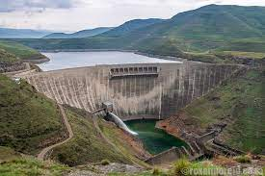
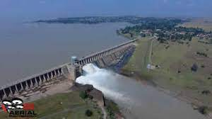
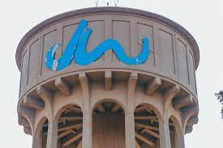
1. Katse Dam in Lesotho (DWS- Lesotho)
2. Vaal Dam in IVRS (DWS – raw, untreated water)
4. Joburg Water reservoir
3. Rand Water treatment to drinking water quality,
storage and pumping

Slide 4
Root causes of the current challenges
Rand Water’s is already exceeding its abstraction limit from the IVRS
It will only be possible for Rand Water to increase its abstraction of water from the IVRS after LHWP Phase 2 comes online
Rand Water has a R35 billion capital programme which is timed to result in substantial additional treatment and storage capacity becoming available when LHWP Phase 2 comes online
In this context, the demand-supply relationship for treated water in Gauteng is very tight and the system is vulnerable to disruptions caused by heavy load shedding, electro-mechanical breakdowns or theft of cables
Usually, such breakdowns would not have a noticeable effect on water supply due to the ability to draw on reserve supply capacity, but now there is no reserve supply capacity for treated water
Because the water is usually gravity-fed from municipal reservoirs to households, high-lying areas are worst affected by disruptions in supply
4

Slide 5
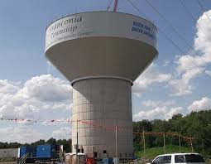
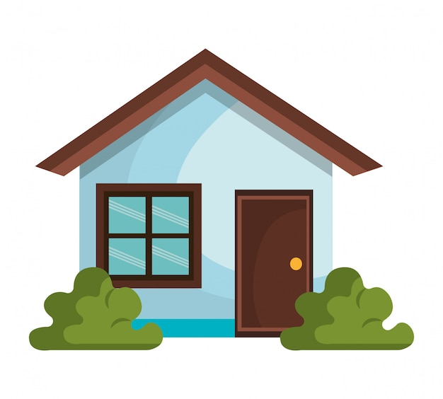
Gravity-fed water reticulation system
Reservoir
High lying area
Water pressure head
Low lying area
If the water level in the reservoir is too low, there is not enough pressure to feed water to high lying areas

Slide 6
What needs to be done?
DWS: work with the Lesotho Highlands Development Authority need to ensure that LHWP2 is completed as soon as possible
Joburg Water and other municipalities which receive water from Rand Water:
Improve their billing and revenue collection
Municipal Councils must allocate sufficient funding for maintenance and leak reduction, as well as investment in additional pumps, reservoirs and pipelines that can make the system less vulnerable to disruptions
Rand Water and Joburg Water and the other municipalities need to continue to closely coordinate their responses to disruptions
Everyone needs to work together to bring down the average per capita water consumption in Gauteng of 253 litres per day closer to world average of 173 litres per capita per day
Even after LHWP Phase 2 comes on stream, Gauteng’s long-term water consumption will need to be carefully managed, because there are limits to which further phases of LHWP or other water transfer projects can continue to provide additional water to Gauteng at an affordable cost
6

Slide 7
Thank you

